Slide 1




ML Project Workshop 2
Davis Data Science Club
Feature Selection
Train/Test
Accuracy

Slide 2

What will we be doing?
2 part project workshop!
Part 1 (05/01):
Overview of ML
Introduction to data
Set Up
EDA
Part 2 (Today - 5/15!):
Modeling - Train and Test
Algorithms
Accuracy

Slide 3

Which supervised learning algorithm?

Slide 4
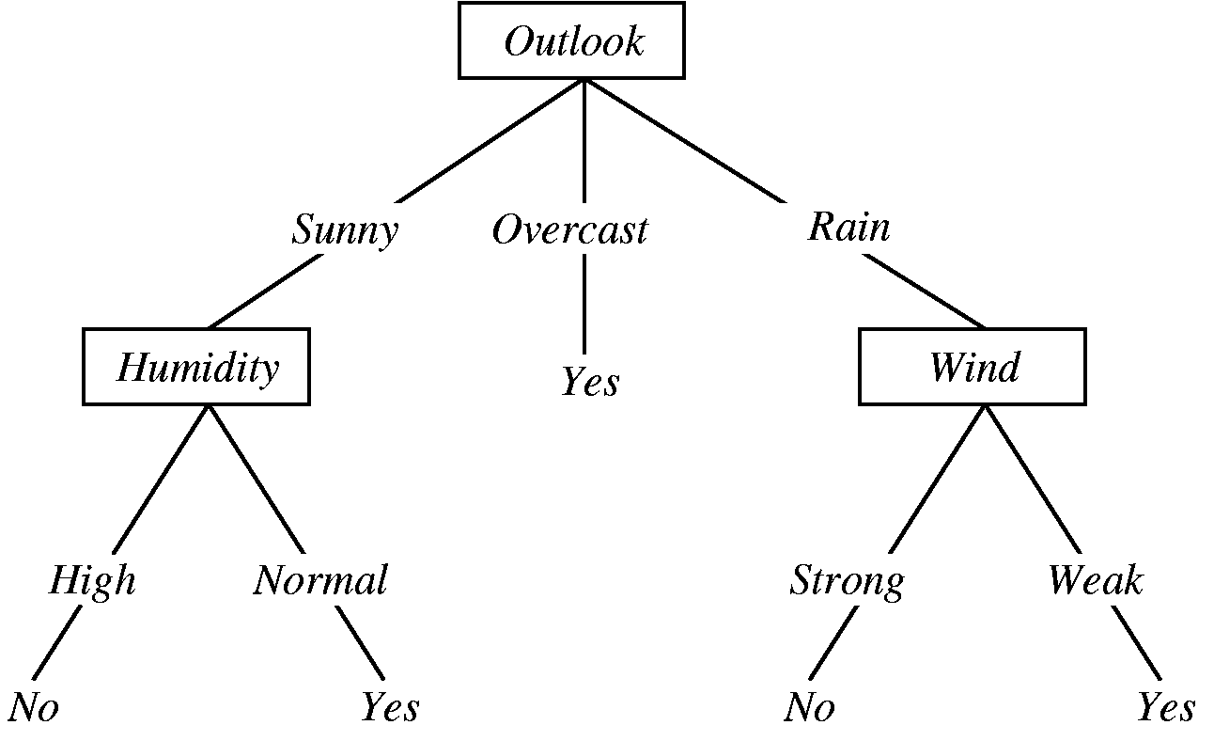
Decision Trees
Notes:
Concept: Decision Trees are a type of supervised learning algorithm used for both classification and regression tasks. They work by splitting the data into subsets based on the value of input features, creating a tree-like model of decisions.
How It Works:
Root Node: Start with the entire dataset and choose the best feature to split it, based on a criterion like Gini impurity or information gain.
Splitting: Recursively split the data into subsets, creating branches of the tree. Each split is chosen to maximize the separation of the data according to the target variable.
Leaf Nodes: Once the data cannot be split further (or another stopping criterion is met), the leaves represent the final output (class labels for classification, average/mean value for regression).

Slide 5
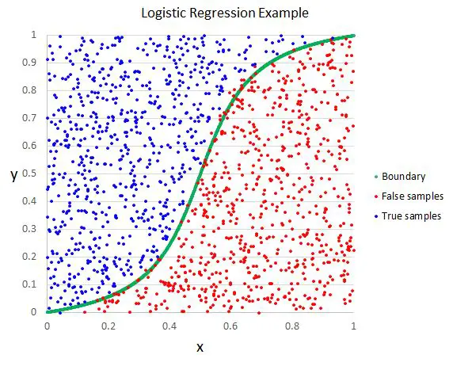
Logistic Regression
Notes:
Concept: Logistic Regression is a statistical model used primarily for binary classification tasks. It models the probability that a given input belongs to a particular class.
How It Works:
Linear Combination: Compute a weighted sum of the input features.
Logit Function: Apply the logistic (sigmoid) function to this weighted sum to transform it into a probability value between 0 and 1.
Thresholding: Assign the input to one of the two classes based on a probability threshold (usually 0.5).

Slide 6
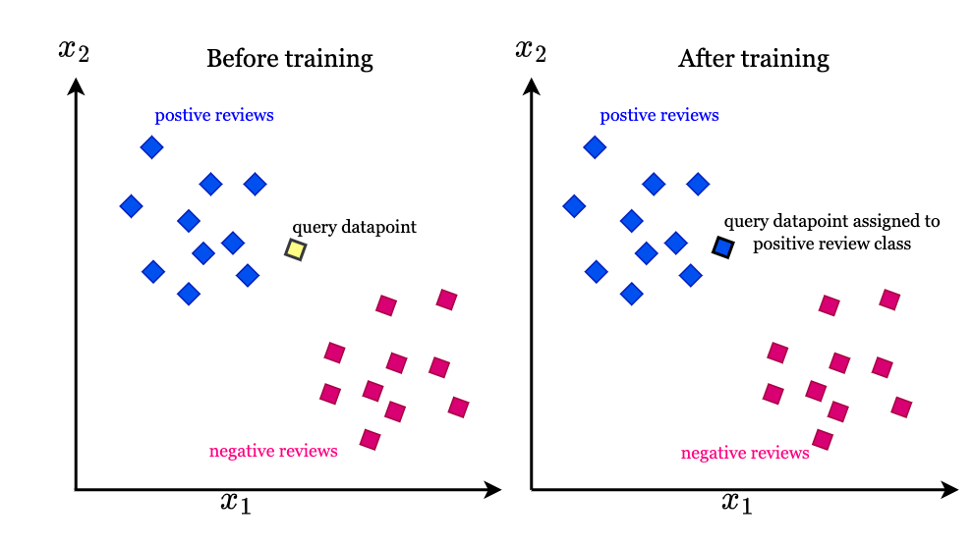
K-Nearest Neighbors
Notes:
Concept: K-Nearest Neighbors is a simple, instance-based learning algorithm used for both classification and regression. It makes predictions based on the k most similar training examples in the feature space.
How It Works:
Distance Metric: Choose a distance metric (e.g., Euclidean distance) to measure similarity between instances.
Finding Neighbors: For a given input, find the k closest training instances.
Prediction:
Classification: Assign the class label that is most frequent among the k neighbors.

Slide 7
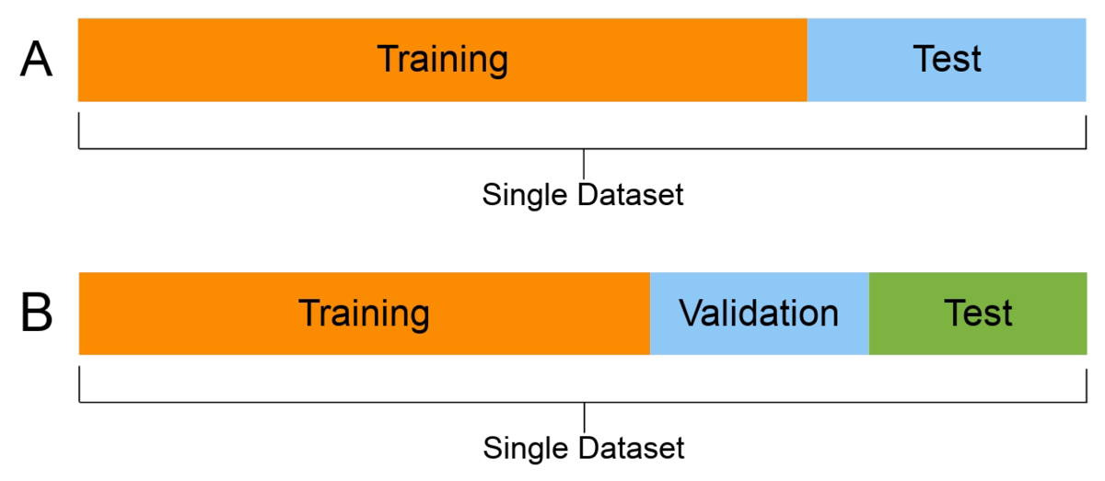
Partitioning the dataset for the model

Slide 8
Train/Test/Validation split
Model learns from the training set, parameters and weights are fit on the data
Model is tuned on the validation set while training
Is the model learning properly?
Model is evaluated on the test set
How good is the model?
Common practice: 80-20 -> 80-10-10, 70-30 -> 70-15-15

Slide 9

Overfitting

Slide 10
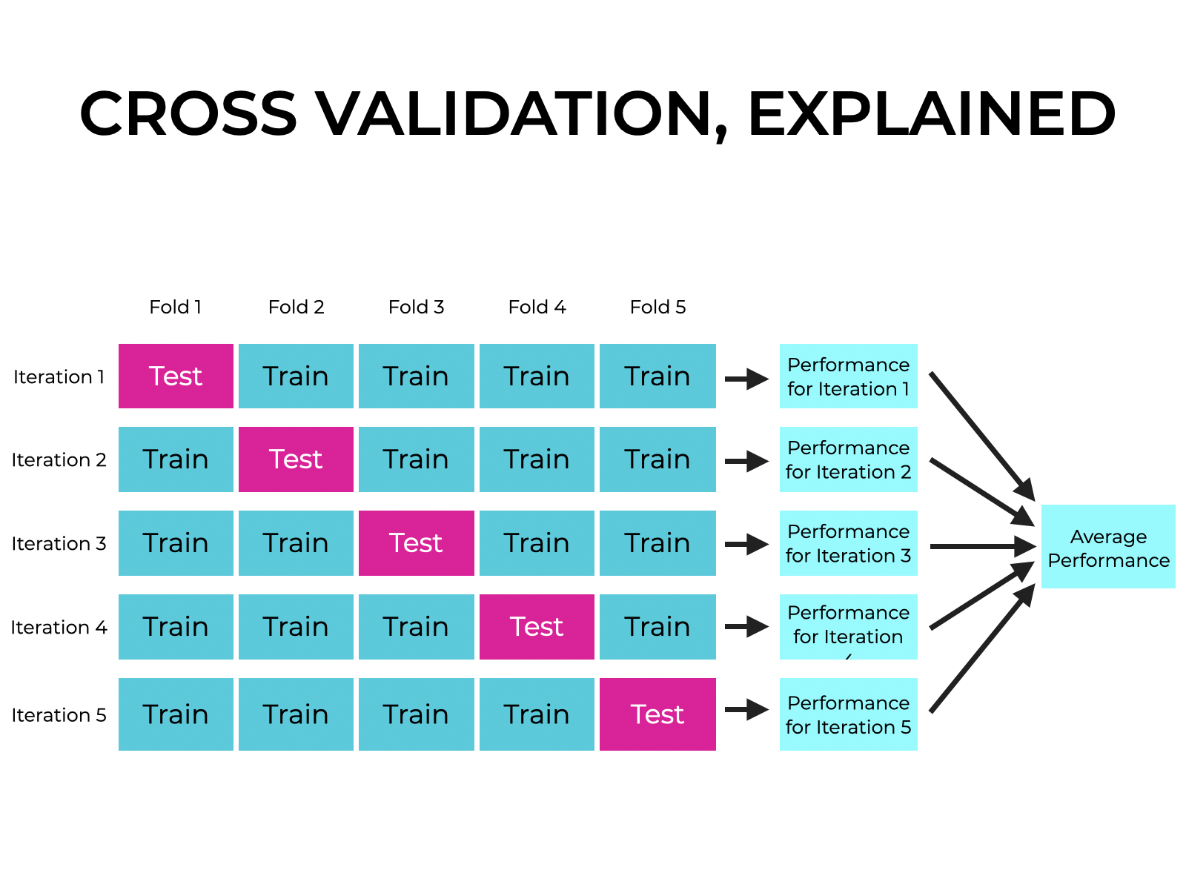
Cross-validation
Splitting the data into subsets (called folds) and rotating the training and validation among them.
Each fold has approximately the same size.
Data can be randomly selected in each fold or stratified.
All folds are used to train the model except one, which is used for validation. That validation fold should be rotated until all folds have become a validation fold once and only once.

Slide 11
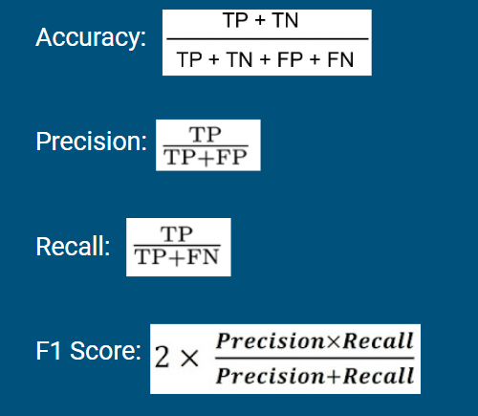
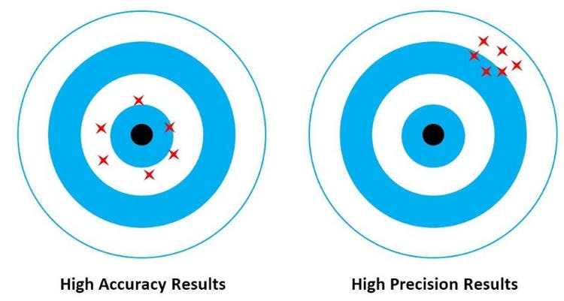
Metrics

Slide 12


Improving the model
Feeding it more data!
Taking a step back a look at the features again (feature selection/engineering)
Can we select better variables?
Can we transform the variables in way that helps the model learn patterns?
Parameter tuning
ML model
DATA

Slide 13
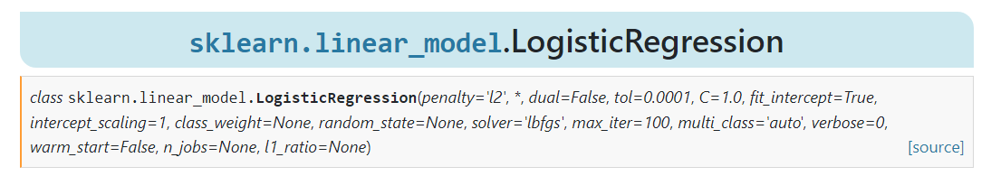
Parameter tuning
The models are sophisticated and give you a lot of “customization”
There’s many parameters to experiment with

Slide 14
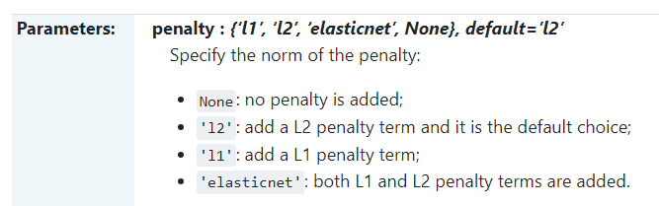
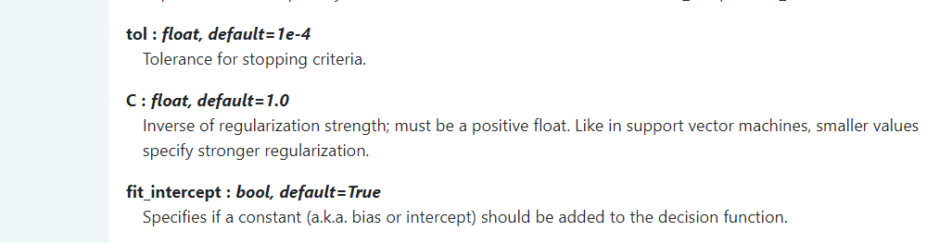
Parameter tuning

Slide 15
Now what?
Feature Selection
Train/Test
Machine Learning Algorithms
Accuracy

Slide 16
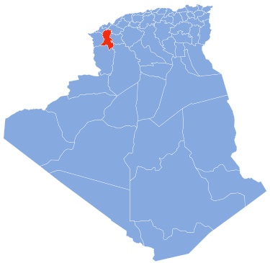
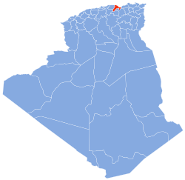
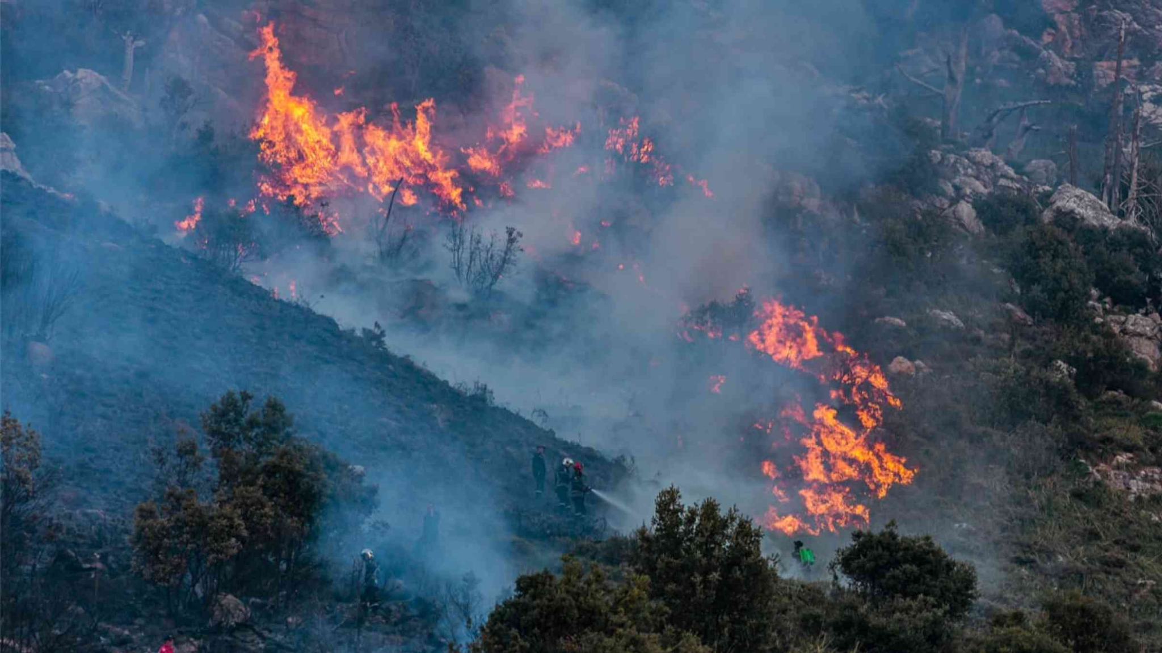
Project: Algerian Forest Fires
How can we predict the likelihood of forest fires given weather observations?
Sidi Bel-abbes
Bejaia
2012

Slide 17
About the Data
Date : (DD/MM/YYYY) Day, month ('june' to 'september'), year (2012) Weather data observations
Temp : temperature noon (temperature max) in Celsius degrees: 22 to 42
RH : Relative Humidity in %: 21 to 90
Ws :Wind speed in km/h: 6 to 29
Rain: total day in mm: 0 to 16.8 FWI Components
Fine Fuel Moisture Code (FFMC) index from the FWI system: 28.6 to 92.5
Duff Moisture Code (DMC) index from the FWI system: 1.1 to 65.9
Drought Code (DC) index from the FWI system: 7 to 220.4
Initial Spread Index (ISI) index from the FWI system: 0 to 18.5
Buildup Index (BUI) index from the FWI system: 1.1 to 68
Fire Weather Index (FWI) Index: 0 to 31.1
Classes: two classes, namely Fire and not Fire
Notes:
The dataset includes 244 instances that regroup a data of two regions of Algeria,namely the Bejaia region located in the northeast of Algeria and the Sidi Bel-abbes region located in the northwest of Algeria.
122 instances for each region.
The period from June 2012 to September 2012. The dataset includes 11 attribues and 1 output attribue (class) The 244 instances have been classified into fire(138 classes) and not fire (106 classes) classes

Slide 18
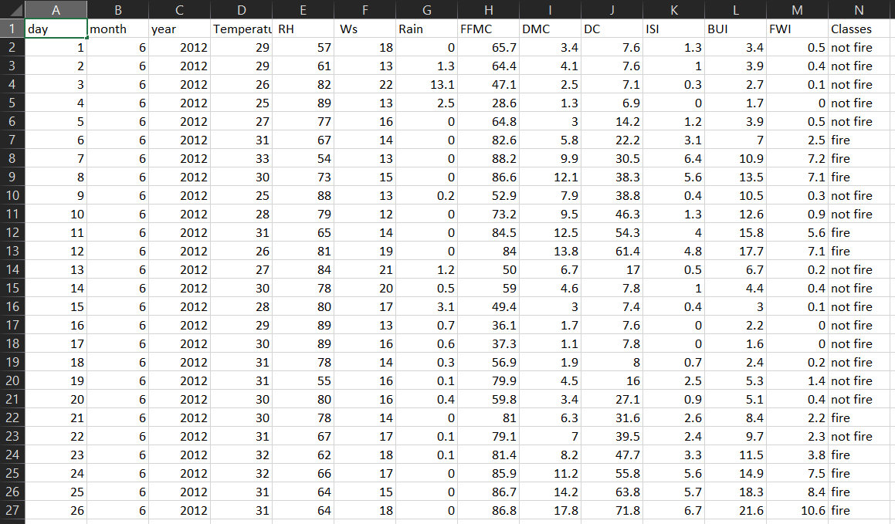
About the Data
Notes:
122 instances for each region.
The period from June 2012 to September 2012. The dataset includes 11 attribues and 1 output attribue (class) The 244 instances have been classified into fire(138 classes) and not fire (106 classes) classes

Slide 19

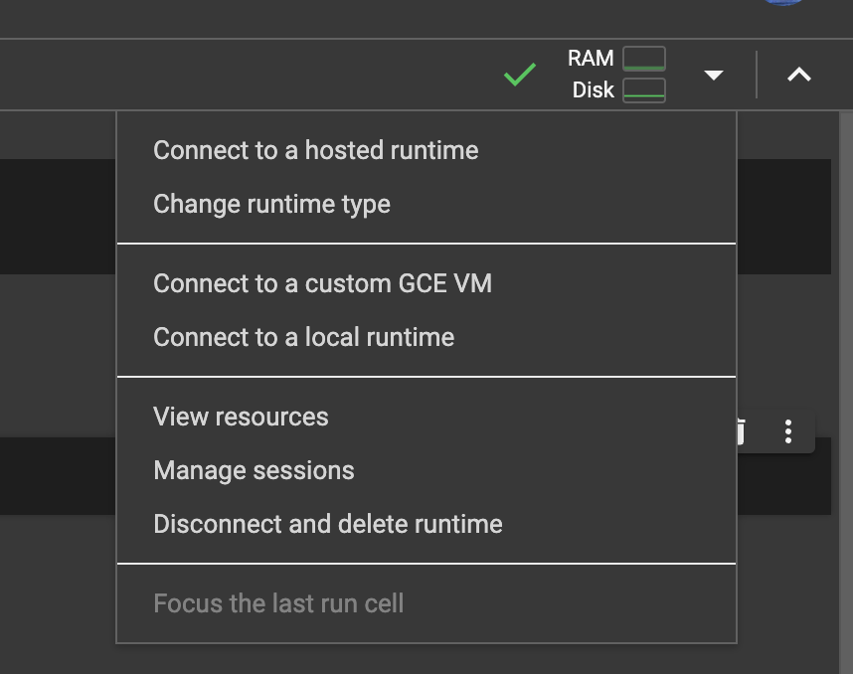
Google Colab
Google Colab: https://colab.google/
Default language should be Python3
To change to R:
Go to the down arrow next to RAM and Disk
Click on change runtime type
Then select R
Link to notebook to follow along: https://tinyurl.com/mr2vmmu6
(Need to make a copy if you want to save it)
(Also sent in the discord)
Notes:
Change run

Slide 20
Resources!
Classification models - https://www.mathworks.com/campaigns/offers/next/choosing-the-best-machine-learning-classification-model-and-avoiding-overfitting.html
Train/Test - https://www.geeksforgeeks.org/training-data-vs-testing-data/
Classification metrics - https://www.evidentlyai.com/classification-metrics/accuracy-precision-recall#:~:text=Accuracy%20is%20a%20metric%20that,often%20the%20model%20is%20right%3F

Slide 21

Thank you!
IG: @data.ucd
FB: facebook.com/data.ucd
Website: davisdsc.com
GitHub: Davis-Data-Science-Club
Discord: discord.gg/zCPRKHdM7
Linktree: linktr.ee/davisdsc
Notes:
QR code in case ppl need to sign in
https://linktr.ee/davisdsc
https://discord.gg/zCPRKHdM7
www.davisdsc.com
www.facebook.com/data.ucd

Slide 22
Link to notebook - https://colab.research.google.com/drive/1CL73eiIrPtgPvC4XIxQ5no5qMdbiAuCK?usp=sharing
Real word examples/ applications of ml
Types of ML
Types of algorithms
What we’ll cover in part 1 versus part 2
Google colab set up
Pandas library
https://www.kaggle.com/datasets/sudhanshu432/algerian-forest-fires-cleaned-dataset
https://www.kaggle.com/code/sudhanshu432/eda-and-fe-algerian-forest-fires-dataset
https://www.kaggle.com/code/sudhanshu432/algerian-forest-fires-prediction-regressions

Slide 23
Explain what we’ll be doing and why and how - machine learning, python, libraries, vectorization, cnn
introduce the project and data
clean/transform data?
EDA & visualizations

